Slide 1
AI HEALTHCARE CHATBOT WEBSITE
USING DJANGO

Slide 2
INDEX
Abstract
Objective of project
Problem Statement
Scope & Motivation
Introduction
Literature survey
Existing Method
Disadvantages
Proposed method
Advantages
Project Flow
Hardware and Software Requirements
Architecture
Modules
UML Diagram
Output Screens
Conclusion
Future Work
References

Slide 3
ABSTRACT
With the increasing population of India and a rise in birth rates coupled with advancements in the medical field leading to a decrease in death rates, there is a concerning shortage of doctors to adequately serve the growing population. This issue becomes apparent when visiting government hospitals in cities, where the limited availability of doctors is a major cause of inadequate treatment and, in some cases, even resulting in patient deaths. Furthermore, doctors, being human, are prone to making mistakes in providing accurate treatments, which can also lead to patient fatalities. To address such situations, the development of an intelligent and smart chat bot that can offer advice to both doctors and patients becomes crucial, potentially saving the lives of hundreds of people. Virtual assistants, including chat bots, have the potential to assist patients and healthcare providers with various medical-related tasks. Chat bots are computer programs designed to engage in conversations with individuals, offering assistance through text messages, applications, or instant messaging. These bots can identify symptoms and provide diagnoses based on specific symptoms, as well as recommend appropriate doctors for prompt responses. While chat bots are already extensively employed in other industries such as retail to enhance processes, their integration into healthcare services can prove invaluable.
Keywords: Intelligent chat bot, Virtual assistants, medical-related tasks, Diagnosis, health service.

Slide 4
OBJECTIVE OF PROJECT
The objective of developing a Health-Care Chat Bot using Support Vector Machines (SVM) and Decision Tree algorithms is to provide an intelligent and interactive conversational system that can assist users in addressing their health-related queries and concerns. The chat bot will leverage the capabilities of both SVM and Decision Tree algorithms to enhance its performance and accuracy in understanding user inputs and providing relevant and reliable responses.

Slide 5
PROBLEM STATEMENT
Develop an AI-powered healthcare chat bot website using Django to enhance patient engagement and streamline healthcare inquiries. The chat bot will provide users with personalized health information, appointment scheduling assistance, and general medical advice. By leveraging natural language processing, the chatbot aims to improve user experience, facilitate health-related conversations, and contribute to efficient healthcare communication. This project addresses the need for accessible, intelligent healthcare support, fostering a more responsive and patient-centric approach in the digital landscape.

Slide 6
SCOPE AND MOTIVATION
Scope:
Create an AI healthcare chatbot website using Django to enhance patient engagement and provide instant medical assistance. The chatbot will offer personalized health advice, answer queries, schedule appointments, and streamline communication. Integrating machine learning enables continuous improvement in diagnosis accuracy. This web platform aims to improve healthcare accessibility, reduce response times, and offer a user-friendly experience, contributing to more efficient and patient-centric healthcare services.

Slide 7
SCOPE AND MOTIVATION
Motivation:
An AI healthcare chatbot website with Django is an exciting endeavor that holds immense potential. Your innovative project has the power to revolutionize healthcare accessibility, providing users with instant support and information. By leveraging Django's robust framework, you're not just building a website; you're crafting a digital ally that can enhance patient experiences, streamline communication, and contribute to a healthier, more connected world. Your dedication to this transformative initiative is a step toward a future where technology empowers and transforms healthcare interactions. Keep pushing boundaries; your impact is boundless.

Slide 8
INTRODUCTION
Nowadays, chat bots are becoming increasingly prevalent in various industries, such as IRCTC, banks, and online travel companies like Make My Trip. With the ongoing trend of digitalization, the demand for chat bots in the market continues to grow. One of the main reasons behind the need for medical chat bots in the healthcare industry is the rising population in India and the scarcity of doctors to cater to the needs of this growing population. Additionally, even doctors can make mistakes when diagnosing patients, potentially endangering their lives. For instance, Mohammed Benaziza, a renowned bodybuilder in the 1990s, tragically died due to Hypokalaemia (high potassium level) in his body. He experienced body cramps as a result of this excess potassium, but doctors mistakenly concluded that he was potassium deficient and administered additional potassium, leading to the cramps spreading to his heart and causing his death.

Slide 9
INTRODUCTION
There have been other cases where doctors have made errors as well. To prevent such scenarios, medical chatbots are essential as they can provide guidance to doctors in critical cases. Their application is not limited to doctors alone; they can also be used by the general public in emergencies, where they can provide guidance on initial treatments. Furthermore, if an individual is suffering from a particular disease, the chatbot can assess the type of disease by asking a few questions. Additionally, it can provide information on precautions and remedies that should be taken.

Slide 10
LITERATURE SURVEY
S.NO | YEAR | AUTHORS | TITLE | OUT COMES
1 | 2018 | A. Allen | Morphing telemedicine-telecare-telehealth-ehealth | Because the Internet created new opportunities and challenges to the traditional health care information technology industry, the use of a new term to address these issues seemed appropriate
2 | 2019 | S. L. Murphy, J. Xu, K. D. Kochanek | It shows that emerging technologies are revolutionizing the way of thinking about healthcare. | Nurses, nurse informaticists, and nurse educators should have a clear comprehension of the role of emerging technology in healthcare to optimize clinical practice

Slide 11
LITERATURE SURVEY
S.NO | YEAR | AUTHORS | TITLE | OUT COMES
3 | 2019 | K. Myers, P. Berry | People rely more and more frequently on health tracking devices, connected health devices, and personalized and proximity medicine | it maintains quality control and manages sensitive items while they’re in transit; it can even lower healthcare costs by streamlining the overall process.
4 | 2018 | Flora Amato | Chat bots can be programmed to respond the same way each time | It brings up issues about whether the task mentioned above ought to be assigned to human staff.

Slide 12
EXISTING SYSTEM
The existing system for a healthcare chatbot incorporates blockchain technology and data analysis. This system aims to enhance the security, privacy, and integrity of healthcare data, while also leveraging data analysis techniques to provide valuable insights and improve the overall patient experience. This is more costly to use and time taking process. It can use by multiple authorizations.

Slide 13
DISADVANTAGES
Complex user interface. Making user difficult to recognize the operations
Late response to user due to highly dumped data set
More processing time to process huge data

Slide 14
PROPOSED METHOD
The proposed system for a healthcare chatbot integrates Natural Language Processing (NLP) techniques, Decision Trees, and Support Vector Machines (SVM) to create an advanced and intelligent healthcare chatbot solution.
The chatbot utilizes NLP algorithms to understand and interpret user queries or messages in a natural language format. NLP allows the chat bot to extract relevant information, such as symptoms, medical history, or specific concerns from the user's input. By applying NLP techniques, the chatbot can comprehend and respond effectively to a wide range of user queries, facilitating a more interactive and personalized conversation.

Slide 15
ADVANTAGES
More visually pleasing
Less response time to user
Simple data set
Less processing times.

Slide 16
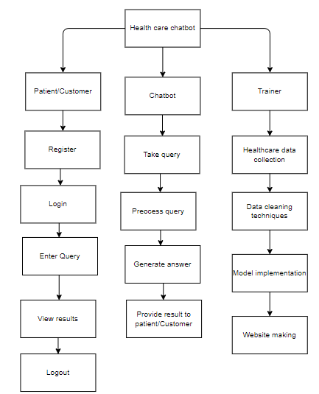
PROJECT FLLOW
Figure: work Flow of Proposed system

Slide 17
HARDWARE & SOFTWARE REQUIREMENTS
SOFTWARE REQUIREMENS
Operating System : Windows 7/8/10
Server side Script : HTML, CSS, Bootstrap & JS
Programming Language : Python
Libraries : Flask, Pandas, Mysql.connector, Os, Smtplib, Numpy
IDE/Workbench : PyCharm

Slide 18
HARDWARE & SOFTWARE REQUIREMENTS
SOFTWARE REQUIREMENS
Technology : Python 3.6+
Server Deployment : Xampp Server
Database : MySQL

Slide 19
HARDWARE & SOFTWARE REQUIREMENTS
HARDWARE REQUIREMENTS
Processor - I3/Intel Processor
RAM - 8GB (min)
Hard Disk - 128 GB
Key Board - Standard Windows Keyboard
Mouse - Two or Three Button Mouse
Monitor - Any

Slide 20
FUNCTIONAL AND NON-FUNCTIONAL REQUIREMENTS
Requirement’s analysis is very critical process that enables the success of a system or software project to be assessed. Requirements are generally split into two types: Functional and non-functional requirements.
Functional Requirements: These are the requirements that the end user specifically demands as basic facilities that the system should offer. All these functionalities need to be necessarily incorporated into the system as a part of the contract. These are represented or stated in the form of input to be given to the system, the operation performed and the output expected. They are basically the requirements stated by the user which one can see directly in the final product, unlike the non-functional requirements.

Slide 21
FUNCTIONAL AND NON-FUNCTIONAL REQUIREMENTS
Examples of functional requirements:
Authentication of user whenever he/she logs into the system
System shutdown in case of a cyber-attack
A verification email is sent to user whenever he/she register for the first time on some software system.
Non-functional requirements: These are basically the quality constraints that the system must satisfy according to the project contract. The priority or extent to which these factors are implemented varies from one project to other. They are also called non-behavioral requirements.

Slide 22
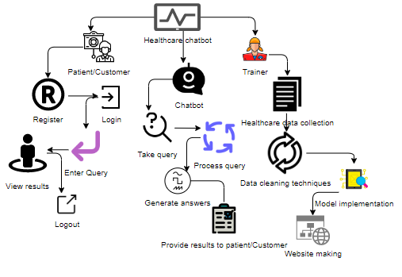
ARCHITECTURE

Slide 23
IMPLEMENTATION AND RESULTS
1. System
1.1 Take Data: System will receive data from the user.
1.2 Pre-processing: The system will undergo for pre-processing.
1.3 Training: The System will be trained.
1.4 Model: The system will work based on model.
1.5 Results: The system will deliver the output to the user.

Slide 24
2. User
2.1 Send Query: User will send Query to the system.
2.2 View Query Result: User will view his query result.

Slide 25
UML DIAGRAMS
Use Case Diagram:
A use case diagram in the Unified Modeling Language (UML) is a type of behavioral diagram defined by and created from a Use-case analysis. Its purpose is to present a graphical overview of the functionality provided by a system in terms of actors, their goals (represented as use cases), and any dependencies between those use cases. The main purpose of a use case diagram is to show what system functions are performed for which actor. Roles of the actors in the system can be depicted.

Slide 26
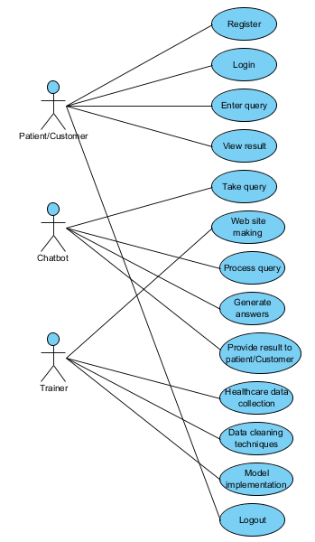
UML DIAGRAMS
Figure: Use Case Diagram

Slide 27
UML DIAGRAMS
Class Diagram:
In software engineering, a class diagram in the Unified Modelling Language (UML) is a type of static structure diagram that describes the structure of a system by showing the system's classes, their attributes, operations (or methods), and the relationships among the classes. It explains which class contains information.

Slide 28
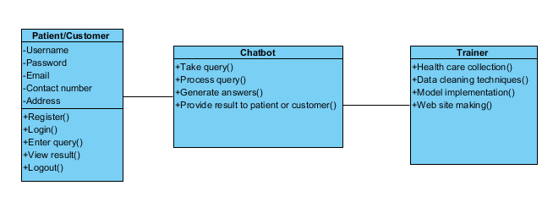
UML DIAGRAMS
Figure: Class diagram

Slide 29
UML DIAGRAMS
Sequence Diagram:
A sequence diagram in Unified Modelling Language (UML) is a kind of interaction diagram that shows how processes operate with one another and in what order. It is a construct of a Message Sequence Chart. Sequence diagrams are sometimes called event diagrams, event scenarios, and timing diagrams.

Slide 30
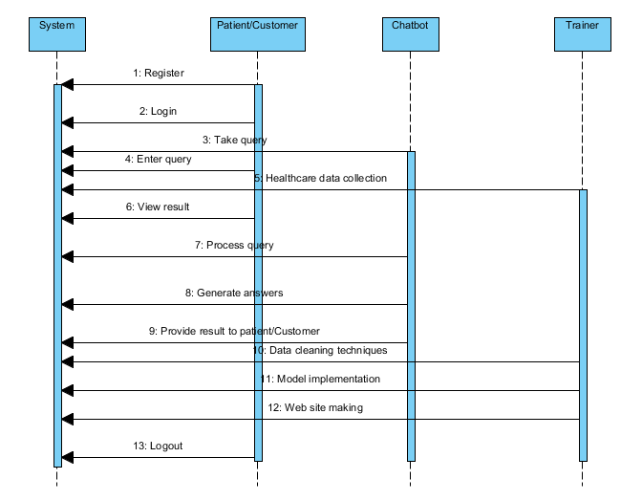
UML DIAGRAMS
Figure: Sequence diagram

Slide 31
UML DIAGRAMS
Collaboration Diagram:
In collaboration diagram the method call sequence is indicated by some numbering technique as shown below. The number indicates how the methods are called one after another. We have taken the same order management system to describe the collaboration diagram. The method calls are similar to that of a sequence diagram. But the difference is that the sequence diagram does not describe the object organization whereas the collaboration diagram shows the object organization.

Slide 32
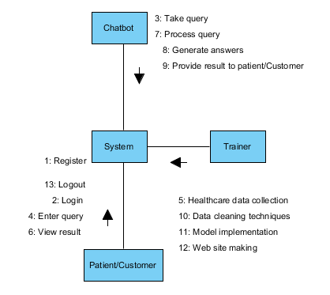
UML DIAGRAMS
Figure: Collaboration diagram

Slide 33
UML DIAGRAMS
Deployment Diagram
Deployment diagram represents the deployment view of a system. It is related to the component diagram. Because the components are deployed using the deployment diagrams. A deployment diagram consists of nodes. Nodes are nothing but physical hardware’s used to deploy the application.

Slide 34
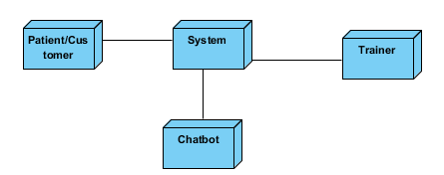
UML DIAGRAMS
Figure: Deployment diagram

Slide 35
UML DIAGRAMS
Activity Diagram:
Activity diagrams are graphical representations of workflows of stepwise activities and actions with support for choice, iteration and concurrency. In the Unified Modelling Language, activity diagrams can be used to describe the business and operational step-by-step workflows of components in a system. An activity diagram shows the overall flow of control.

Slide 36
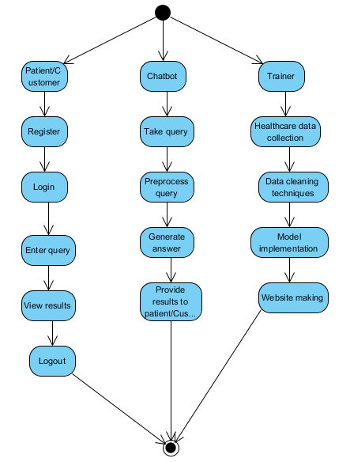
UML DIAGRAMS
Figure: Activity diagram

Slide 37
UML DIAGRAMS
Component Diagram:
A component diagram, also known as a UML component diagram, describes the organization and wiring of the physical components in a system. Component diagrams are often drawn to help model implementation details and double-check that every aspect of the system's required functions is covered by planned development.

Slide 38
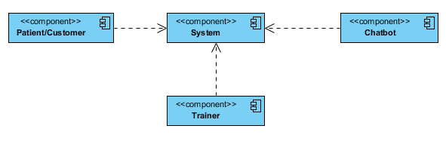
UML DIAGRAMS
Figure: Component diagram

Slide 39
UML DIAGRAMS
ER Diagram:
An Entity–relationship model (ER model) describes the structure of a database with the help of a diagram, which is known as Entity Relationship Diagram (ER Diagram). An ER model is a design or blueprint of a database that can later be implemented as a database. The main components of E-R model are: entity set and relationship set.
An ER diagram shows the relationship among entity sets. An entity set is a group of similar entities and these entities can have attributes. In terms of DBMS, an entity is a table or attribute of a table in database, so by showing relationship among tables and their attributes, ER diagram shows the complete logical structure of a database. Let’s have a look at a simple ER diagram to understand this concept.

Slide 40
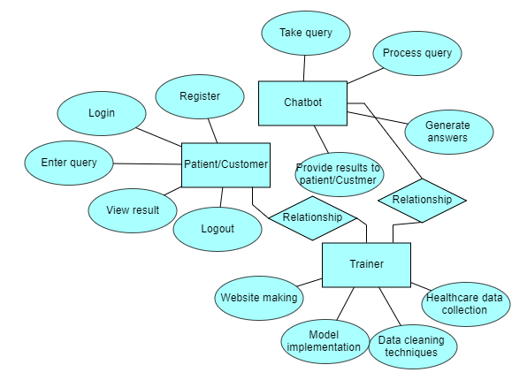
UML DIAGRAMS
Figure: ER diagram

Slide 41
UML DIAGRAMS
DFD Diagram:
A Data Flow Diagram (DFD) is a traditional way to visualize the information flows within a system. A neat and clear DFD can depict a good amount of the system requirements graphically. It can be manual, automated, or a combination of both. It shows how information enters and leaves the system, what changes the information and where information is stored. The purpose of a DFD is to show the scope and boundaries of a system as a whole. It may be used as a communications tool between a systems analyst and any person who plays a part in the system that acts as the starting point for redesigning a system.

Slide 42
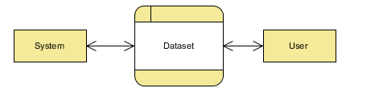
UML DIAGRAMS
Figure: Context Level diagram

Slide 43
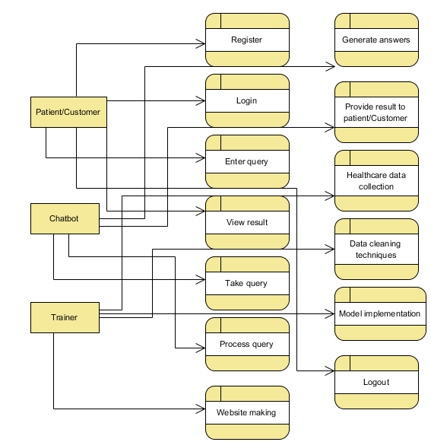
UML DIAGRAMS
FigureLevel-1 diagram

Slide 44
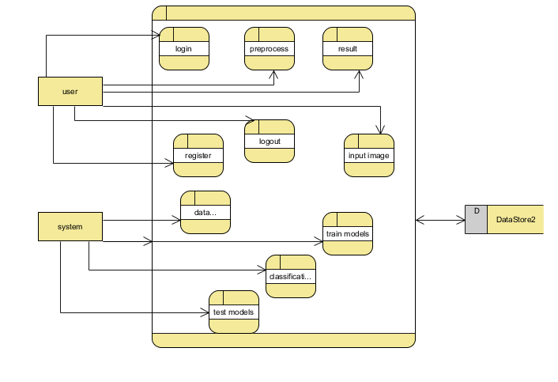
UML DIAGRAMS
Figure:Level-2 diagram

Slide 45
CONCLUSION
Chat bots are an emerging technology that holds immense potential for the future. With their growing popularity among companies, they are expected to have a lasting impact. It is truly exciting to witness the development of this new domain in technology, as it surpasses previous limitations. We are developing this system in response to the increasing population of our country. Although such systems are already available in other countries, they are not yet widely accessible in our own. The shortage of doctors to meet the needs of patients is a well-known issue, particularly evident in the government hospitals throughout the city. By introducing a medical chat bot, we aim to provide medical assistance to patients when doctors are unavailable, ultimately enhancing the efficiency and performance of the medical industry and reducing the mortality rate.

Slide 46
FUTURE ENHANCEMENT
By incorporating these future enhancements, the Health-Care Chat Bot using SVM and Decision Tree can evolve into a more sophisticated and versatile tool, offering advanced capabilities, personalized support, and seamless integration with healthcare systems for the benefit of users' health and well-being.

Slide 47
REFERENCES
[1] A. Allen, ‘‘Morphing telemedicine-telecare-telehealth-ehealth,’’ Telemed Today, Special, no. 2000, 2000.
[2] S. L. Murphy, J. Xu, K. D. Kochanek, and E. Arias, ‘‘Mortality in the United States, 2017,’’ NCHS Data Brief, no. 328, pp. 1–8, Nov. 2018.
[3] K. Myers, P. Berry, J. Blythe, K. Conley, M. Gervasio, D. L. McGuinness, D. Morley, A. Pfeffer, M. Pollack, and M. Tambe, ‘‘An intelligent personal assistant for task and time management,’’ AI Mag., vol. 28, no. 2, p. 47, 2007.
[4] Flora Amato, Stefano Marrone, “Chatbots meet eHealth: automat zing healthcare”, proceeding of diet, May-2018.
[5] Benilda Eleonor V. Comendador, “Pharmabot: A pediatric generic Medicine consultant Chatbot”, proceeding of the JACE, April 2015.

